Slide 1
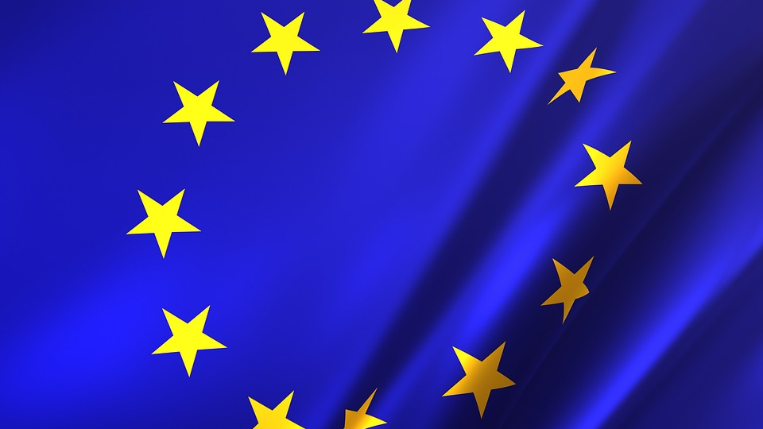
Unity Through Difference

Slide 2
What is the European Union?
The European Union (EU) is a political and economic union of European countries. It was established on November 1, 1993. The roots of modern European integration can be traced back to the post-World War II era, when six Western European countries formed various forms of cooperation, establishing organizations, institutions, and bodies aimed at strengthening unity among them.

Slide 3
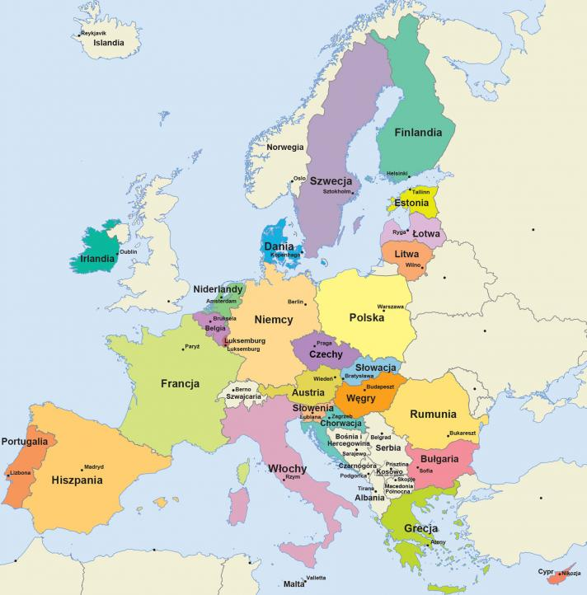
Member States of the European Union
The EU's diverse membership comprises 27 countries, each with its unique heritage, culture, and identity. These nations have united under a shared vision of a brighter future for their citizens. At the core of the EU lies the commitment to collaboration, mutual support, and the pursuit of common goals that benefit all member states.

Slide 4
Goals and Values of the European Union
The EU's foundation is built upon shared values that are fundamental to its existence. These principles guide the organization's actions and aspirations, ensuring that the rights and well-being of its citizens are at the forefront.
Democracy
Human Dignity
Freedom
Equality
Rule of Law
Respect for Human Rights

Slide 5
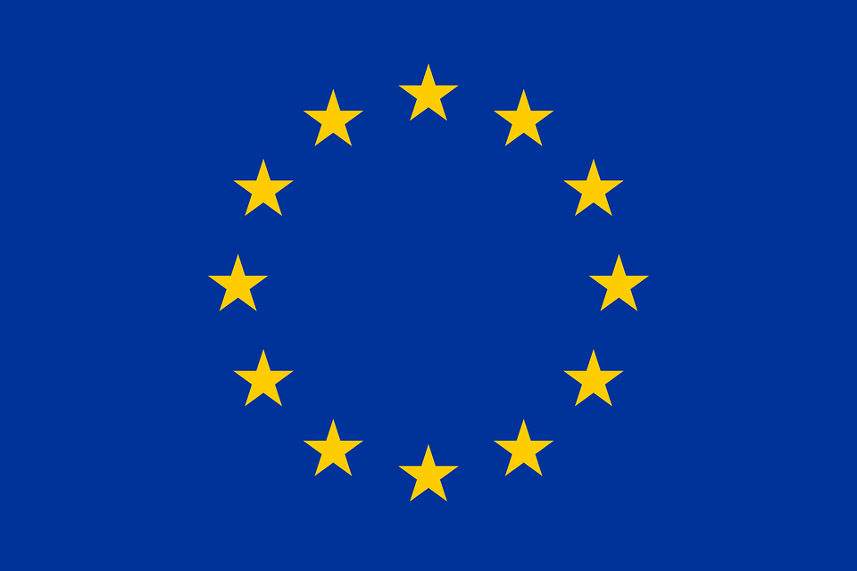
The European Flag: A Symbol of Unity
The EU's flag is a powerful symbol of unity and solidarity among its member states. A circle of twelve golden stars against a blue background represents the harmony and interconnectedness of the European nations. The number of stars does not correspond to the number of member states, but rather signifies unity and ever-growing cohesion.

Slide 6
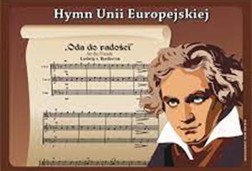
The Anthem of Europe: A Melody of Unity
The instrumental version of Beethoven's "Ode to Joy" from his Ninth Symphony serves as the EU's anthem. Herbert von Karajan's arrangement of this stirring piece was adopted by both the Council of Europe and the EU. Officially performed for the first time in 1972 on Europe Day, the anthem became an integral part of the EU's identity upon its establishment in 1993.

Slide 7
Official Languages of the EU: A Celebration of Diversity
The EU embraces its linguistic diversity, recognizing 24 official languages. This multilingualism reflects the organization's democratic principles and ensures that all citizens can engage with the EU in their own tongue. It empowers individuals to access information, participate in decision-making, and connect with others across the continent.

Slide 8
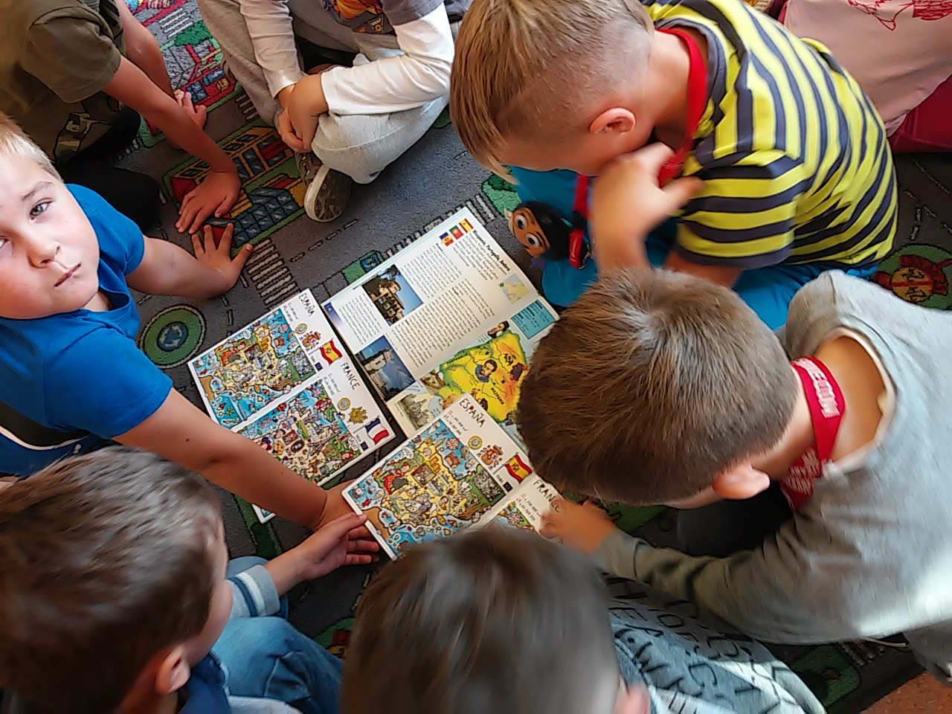
Freedom of Movement: A Cornerstone of the EU
The EU has revolutionized the way people move within its borders. Citizens enjoy the freedom to travel, live, study, and work in any EU member state. This cornerstone of the EU has fostered a sense of interconnectedness and opened up a world of opportunities for Europeans.
To zdjęcie, autor: Nieznany autor, licencja: CC BY-SA

Slide 9
Peace: A Testament to Unity
Since its inception, the EU has been instrumental in fostering peace and cooperation among its member states. The shared values and collaborative spirit of the EU have created an environment where conflict and division have been replaced by dialogue and understanding.

